Slide 1

IS 606 Project
AdityaVenkatesh Annavarapu, Junhyun Kim

Slide 2
Hansori: Beat of Korea
Hansori is a Korean drumming group at EMU
Hansori started in 2010
Performing on and off campus and they have annual concert every December

Slide 3
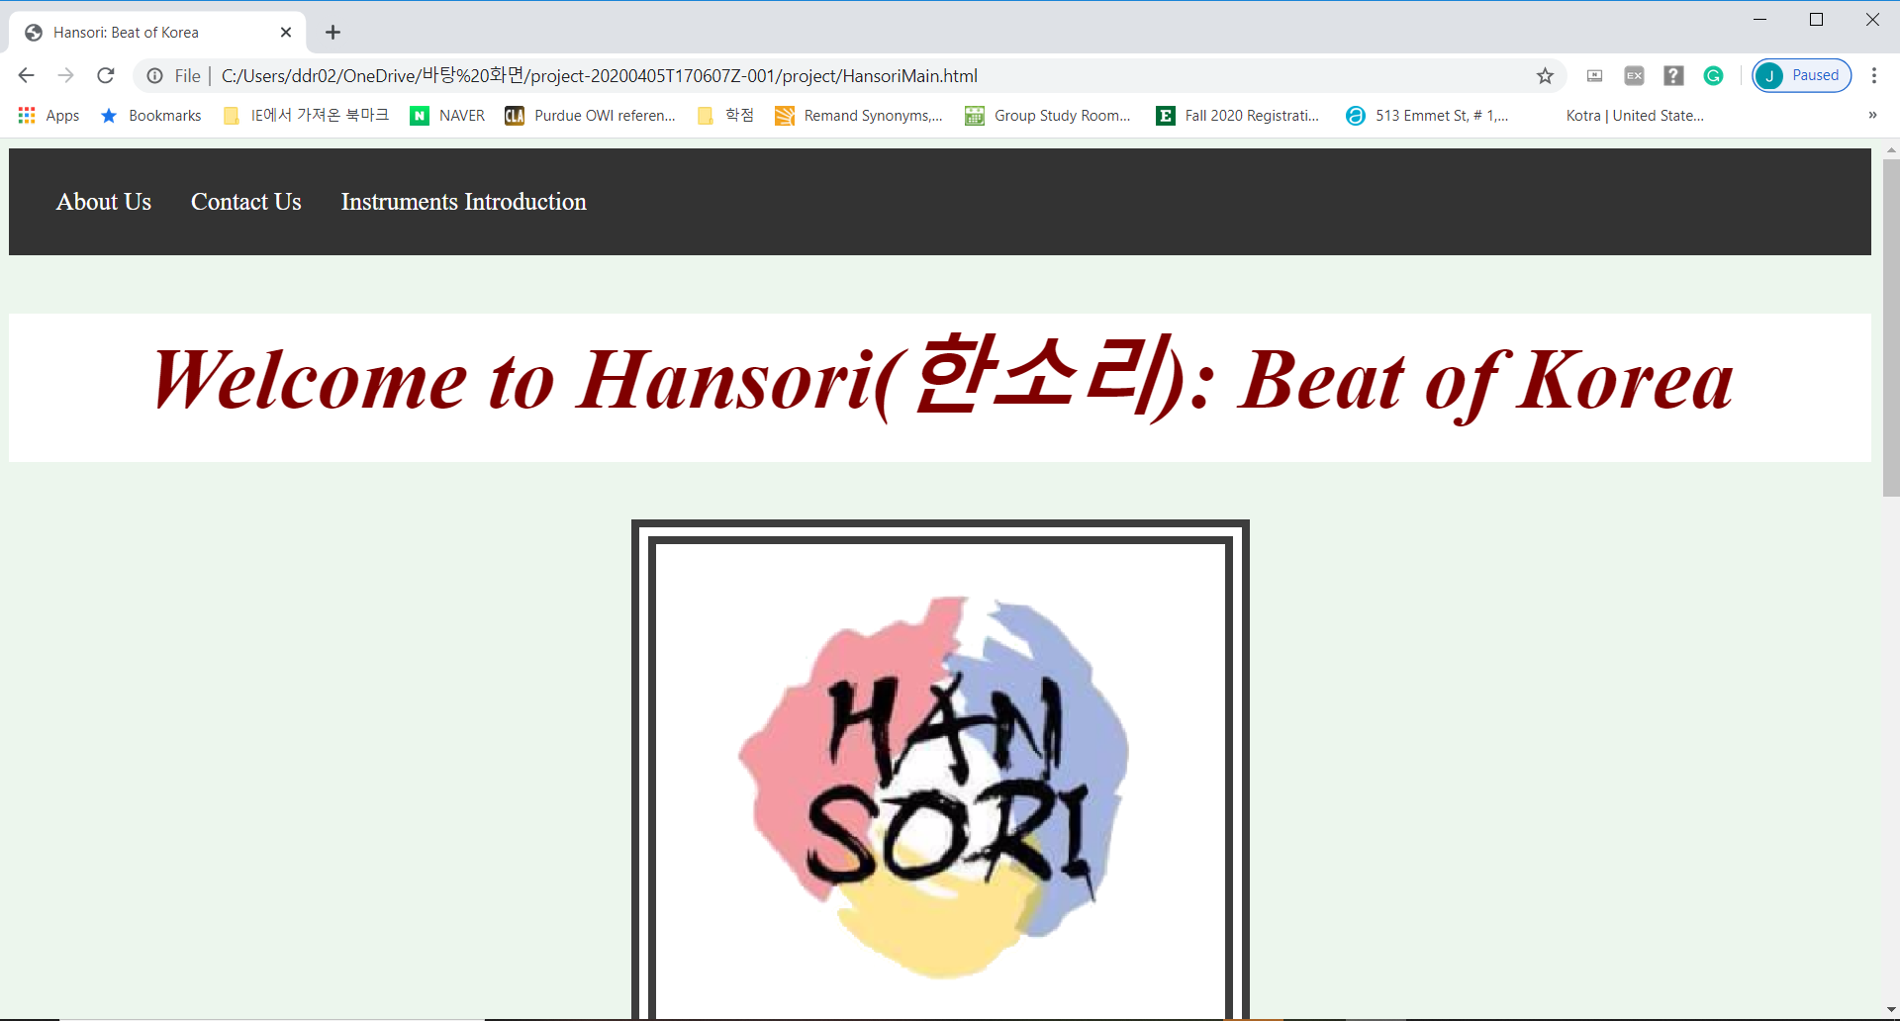

Slide 4
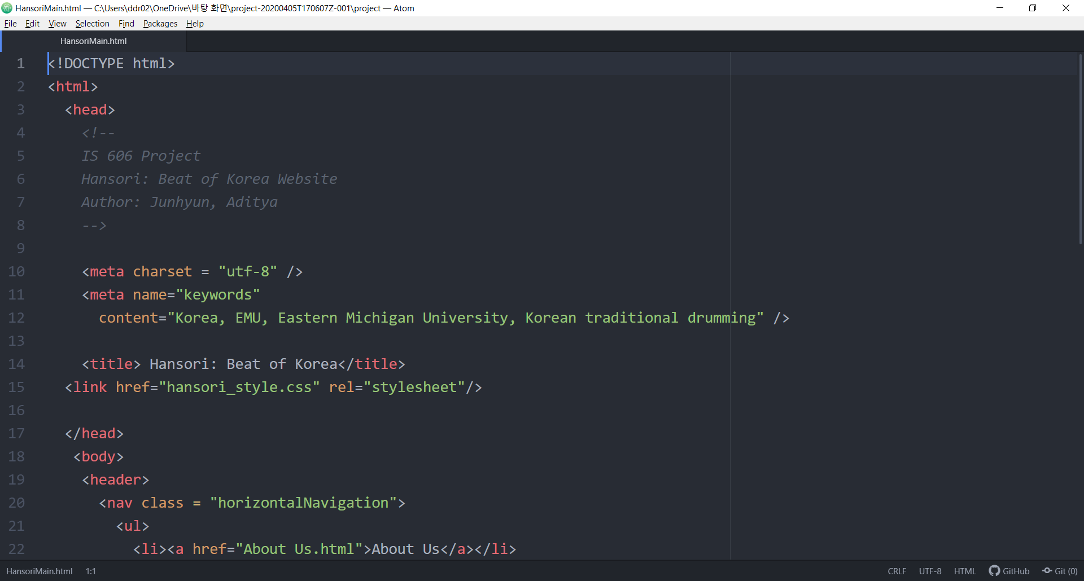
HTML Code –Hansori Main page

Slide 5
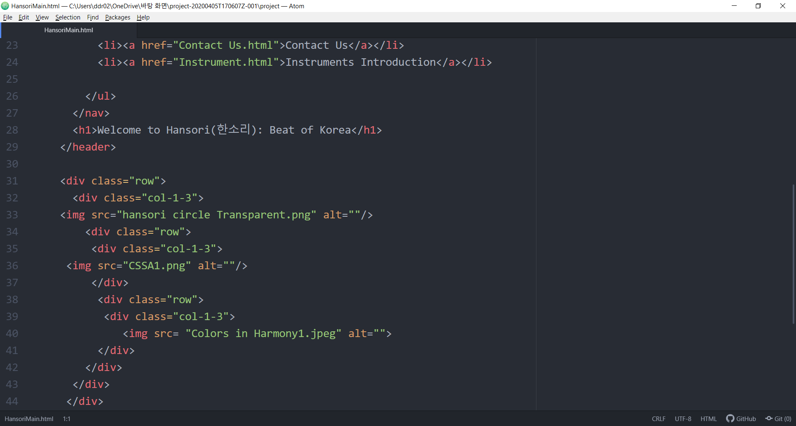

Slide 6
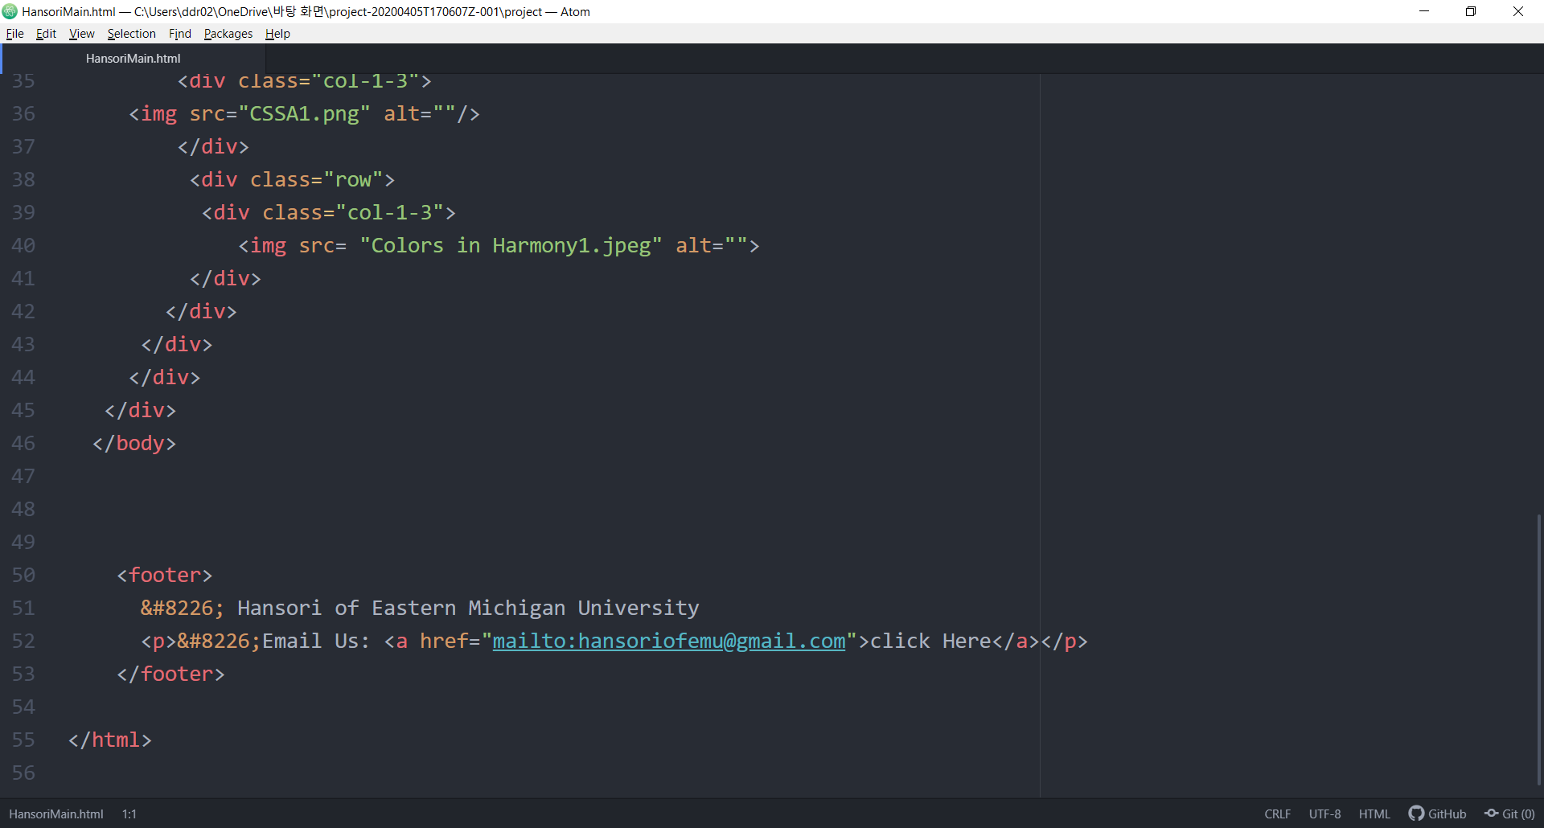

Slide 7
HansoriMain.html
Doctype is an instruction which defines the web browser about the current page written
meta charset UFT-8 means meta is info in the head. Charset is setting utf-8 as a character encoding. This is cable of encoding all characters on the web
meta name is description of html element that summarizes webpage
Title is defined and there is a link which connecting main page and stylesheet
div is html element that groups other elements
Images are included using img src= < “” alt= “” />
<a href= “”> click here </a> is guiding to specified path when clicked

Slide 8
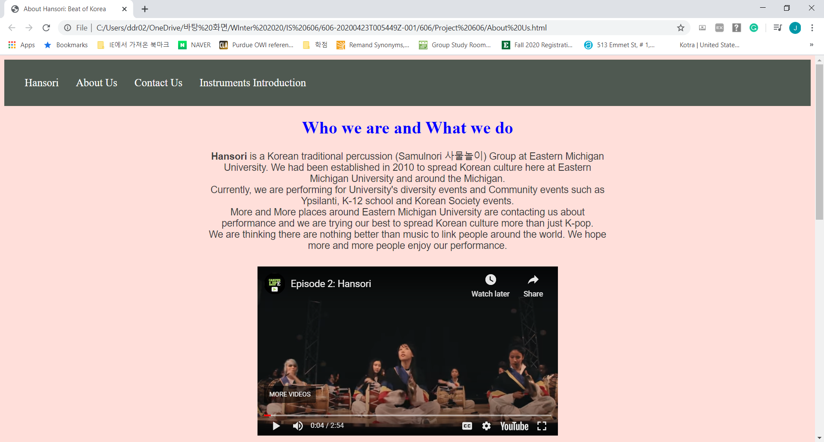
About Us Webpage View

Slide 9
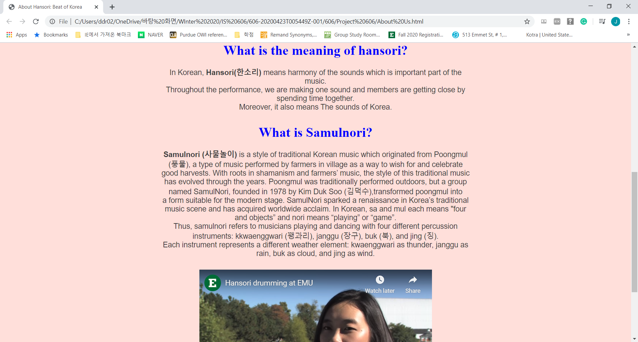
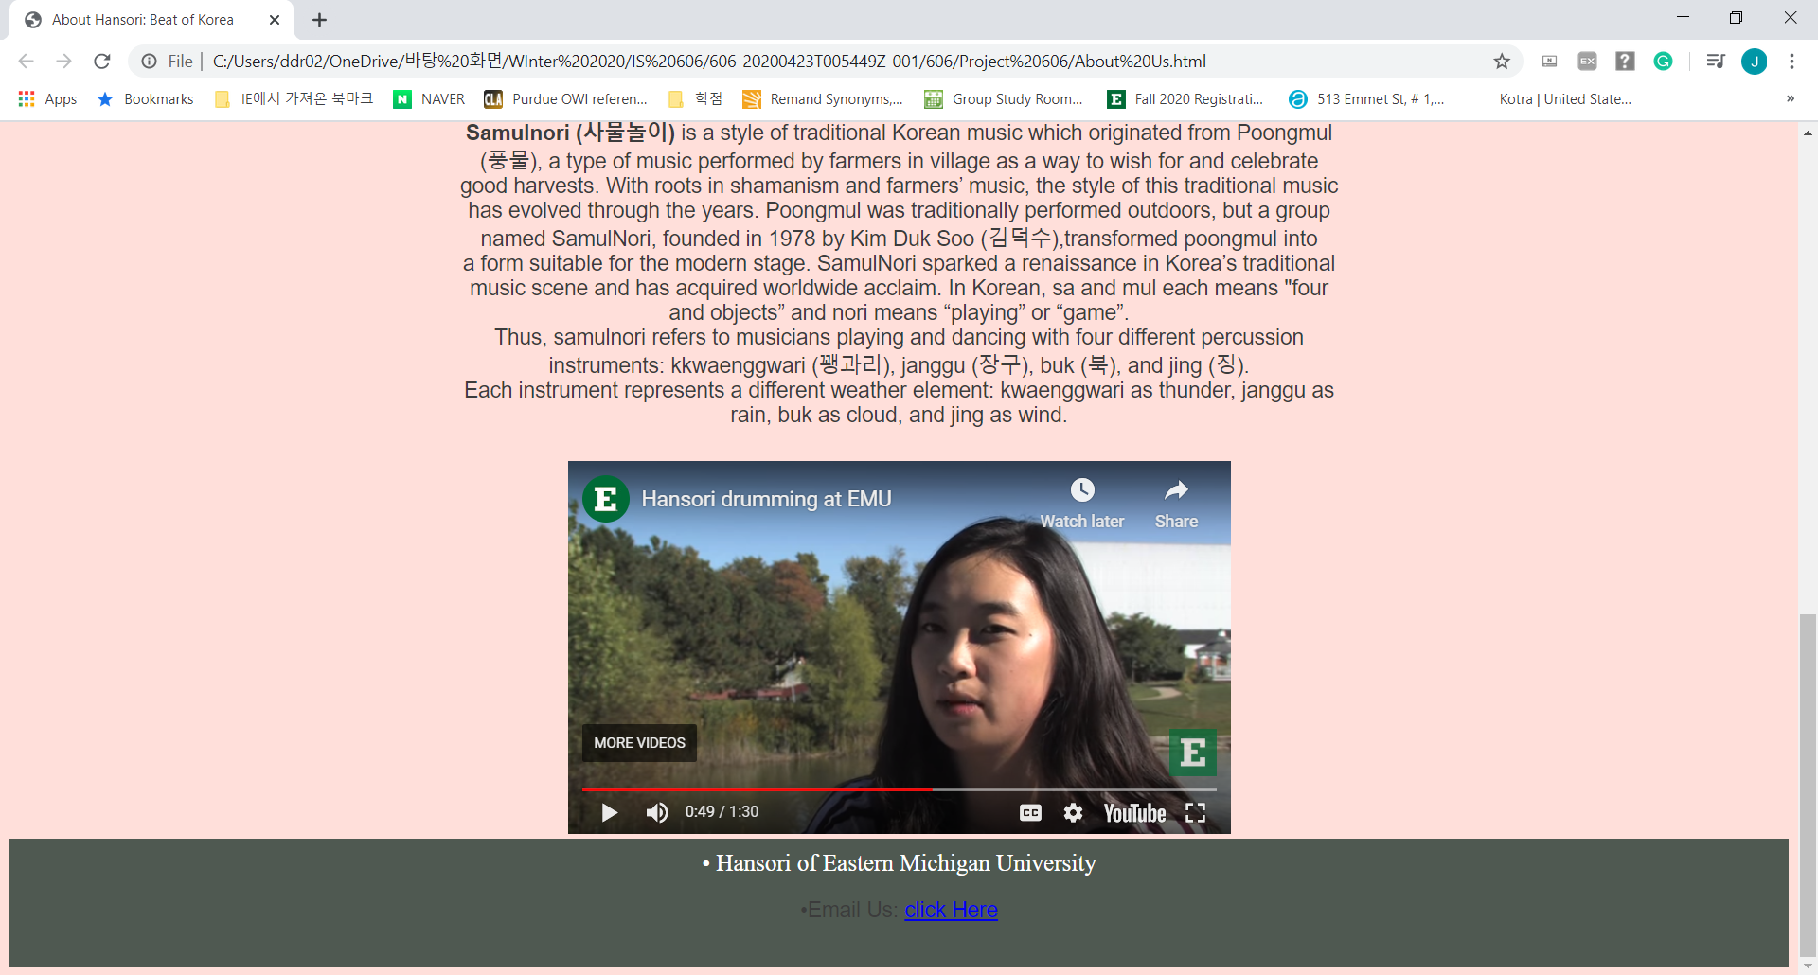

Slide 10
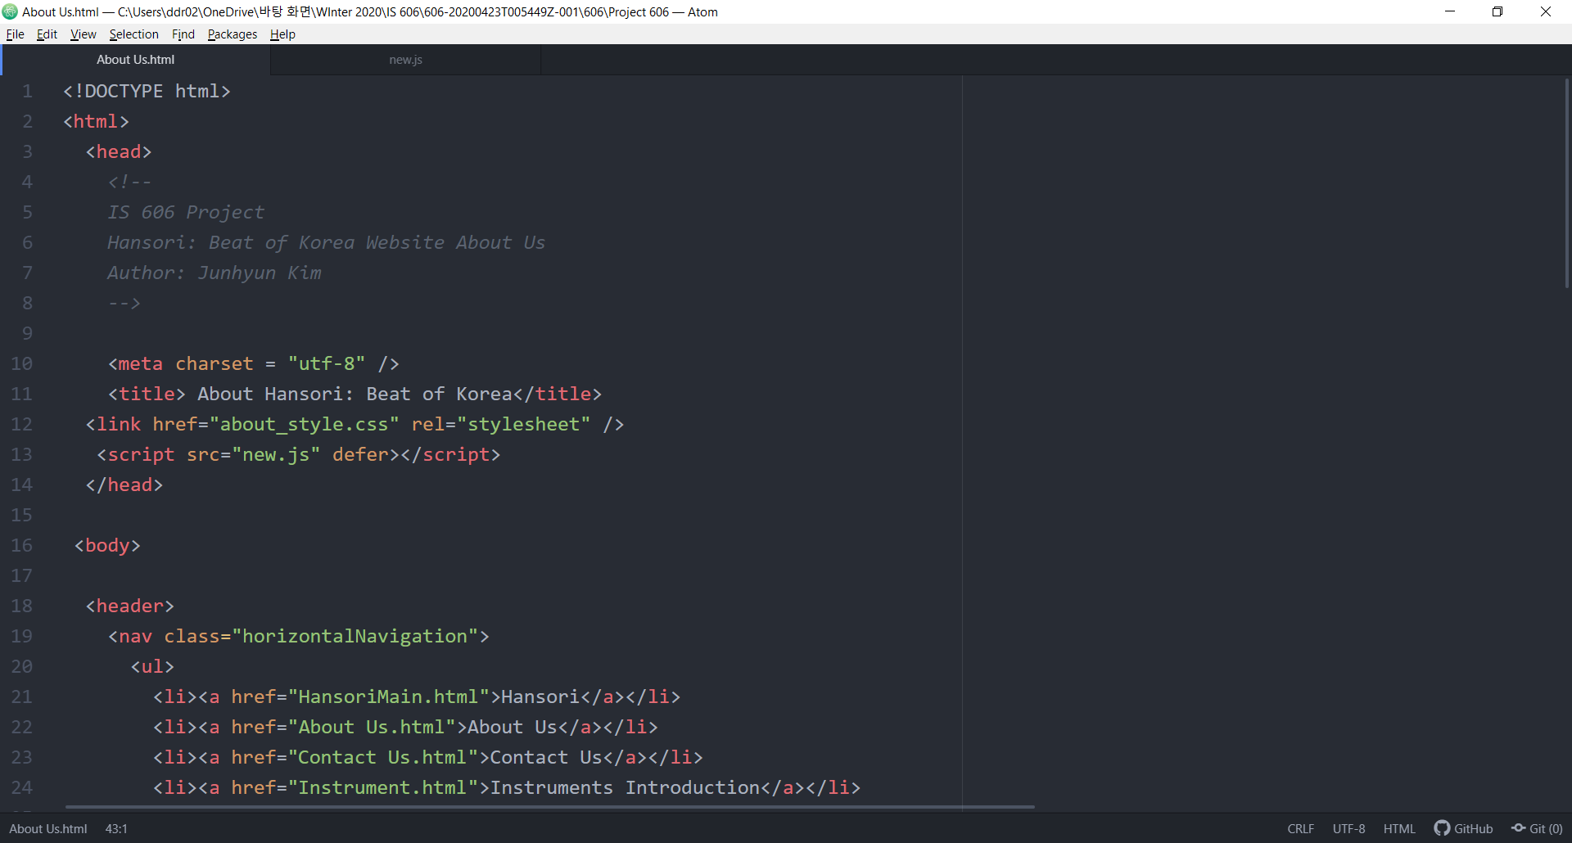
About Us Code

Slide 11
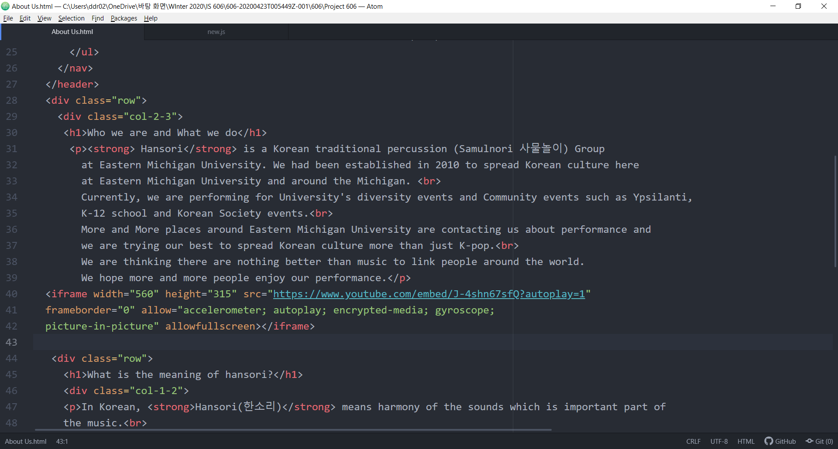

Slide 12
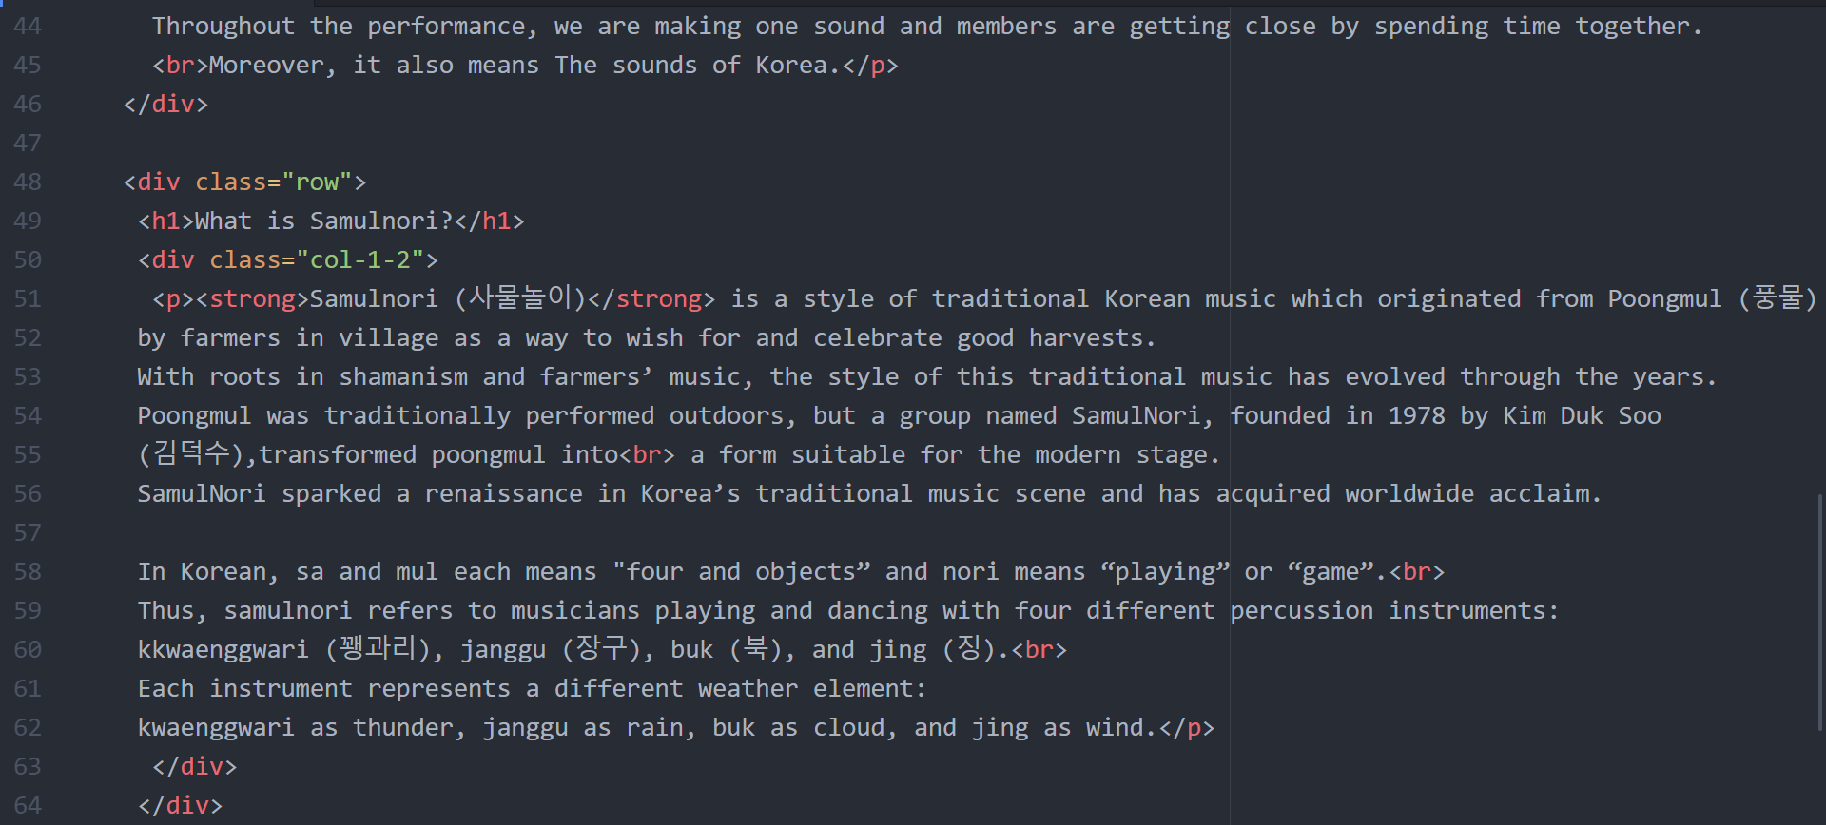

Slide 13
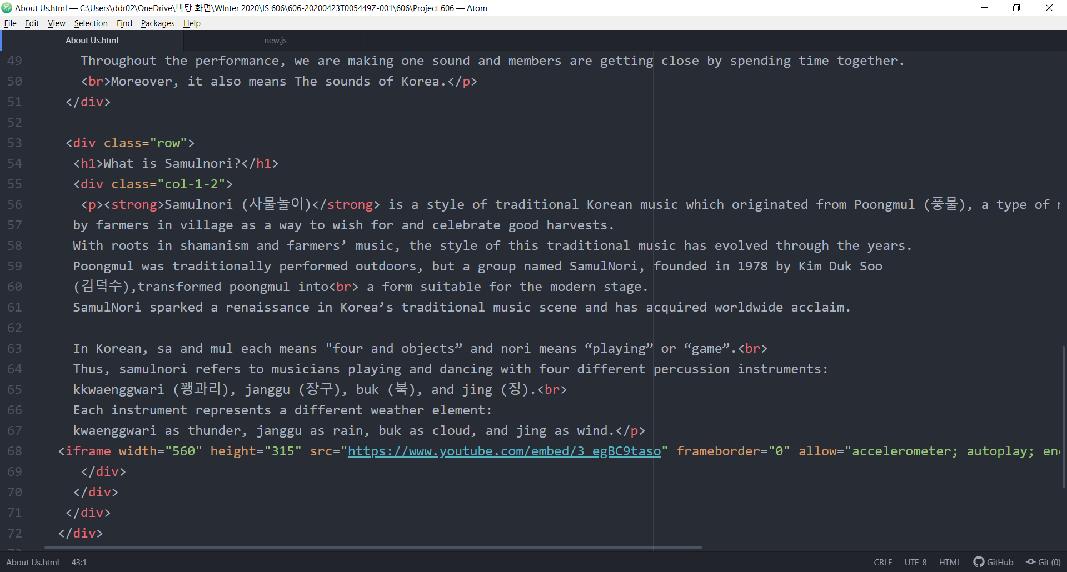

Slide 14
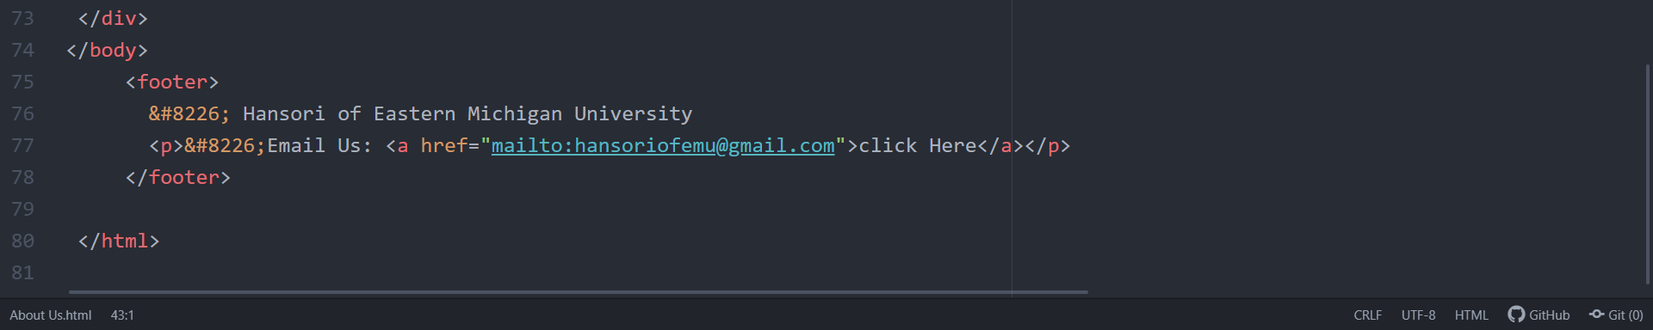

Slide 15
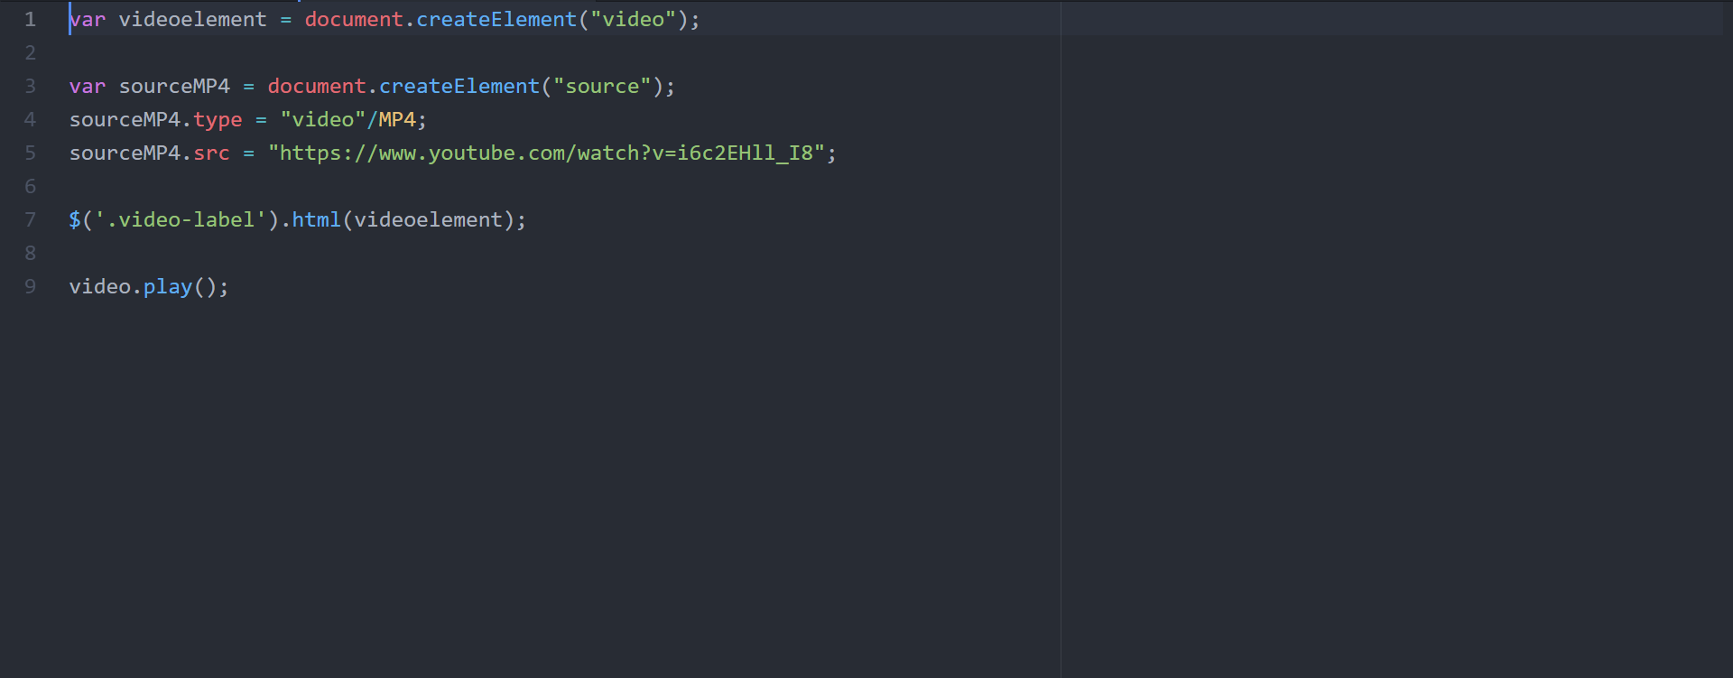
JavaScript for video

Slide 16
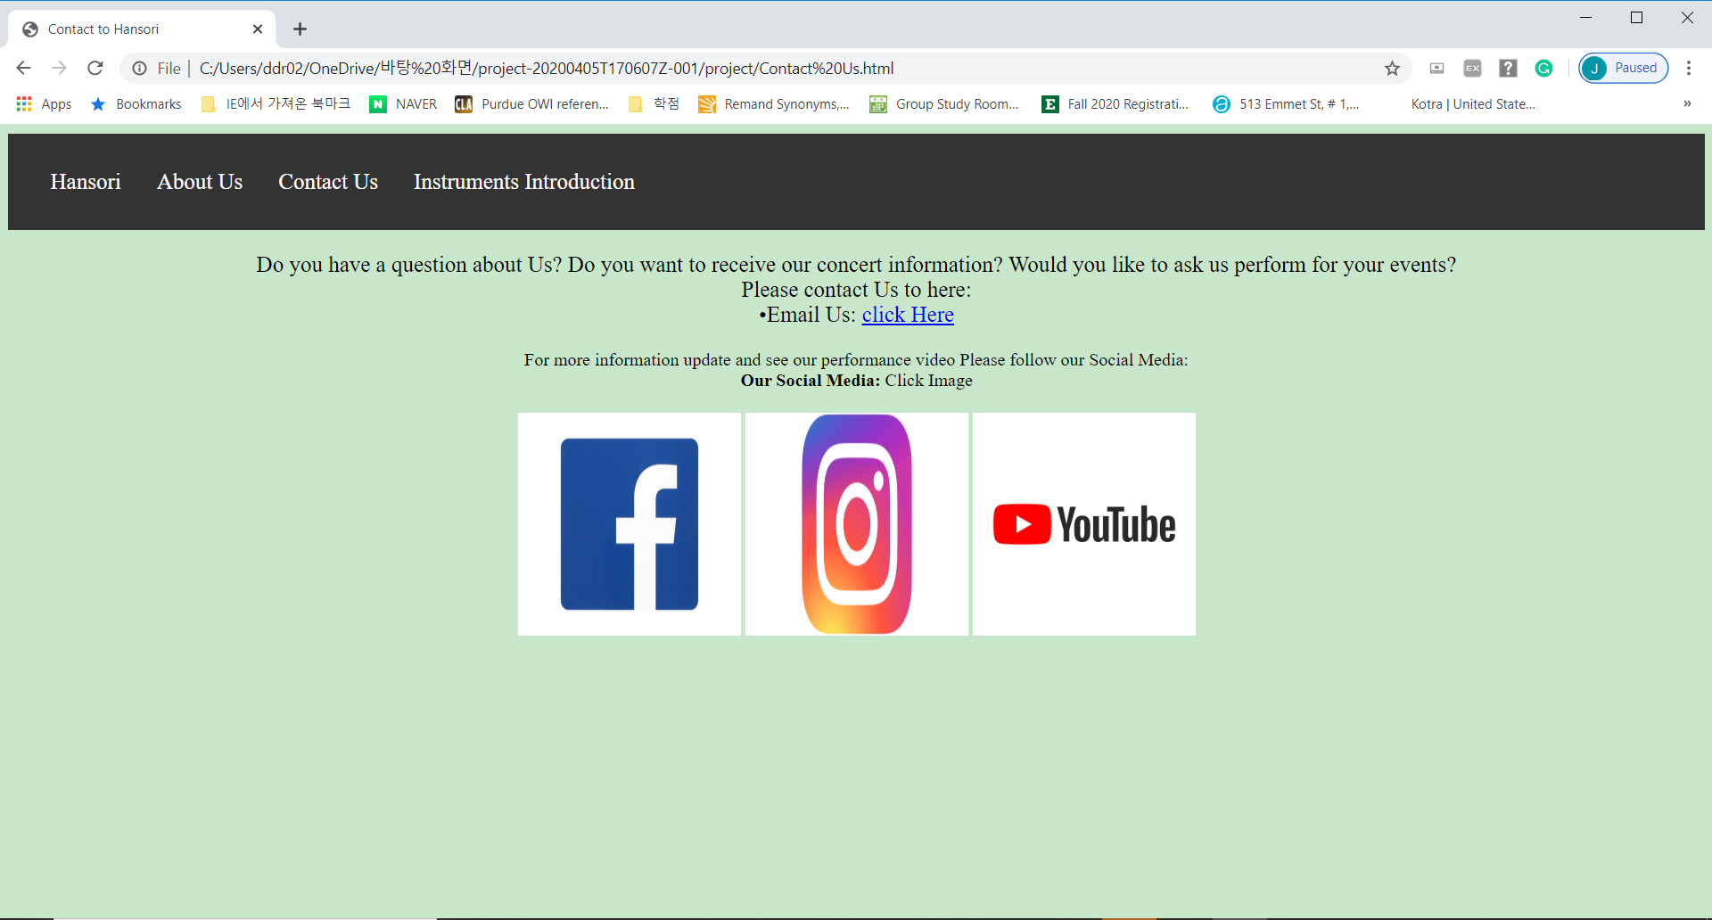

Slide 17
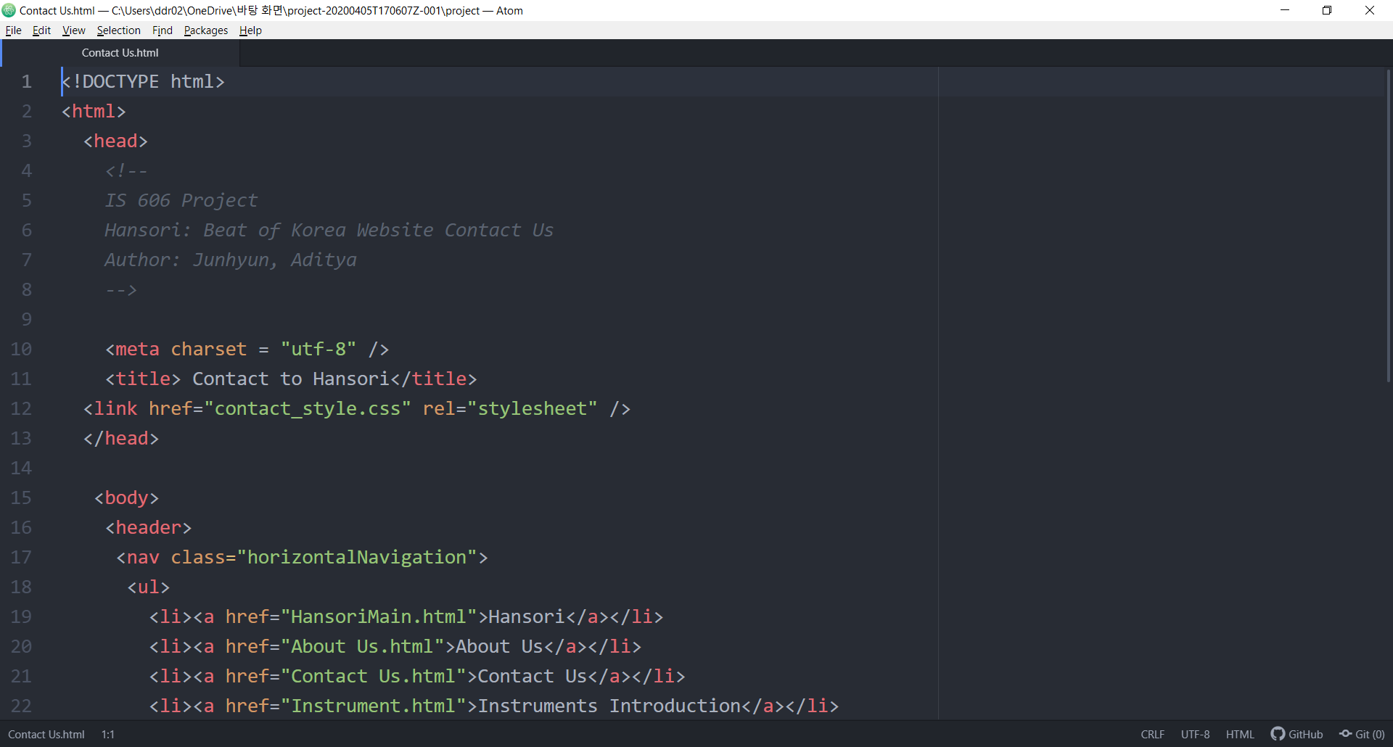
Contact Us Code

Slide 18
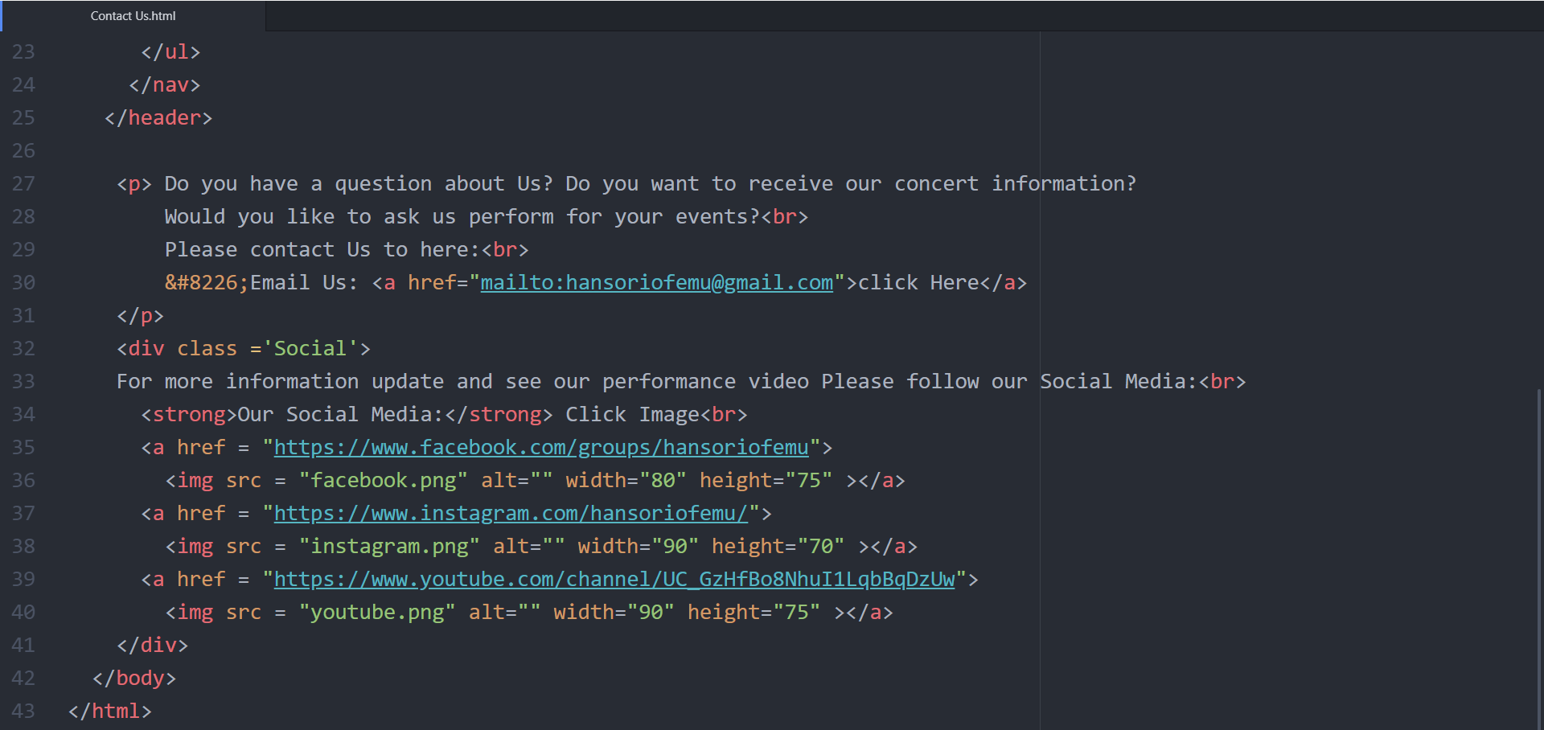

Slide 19
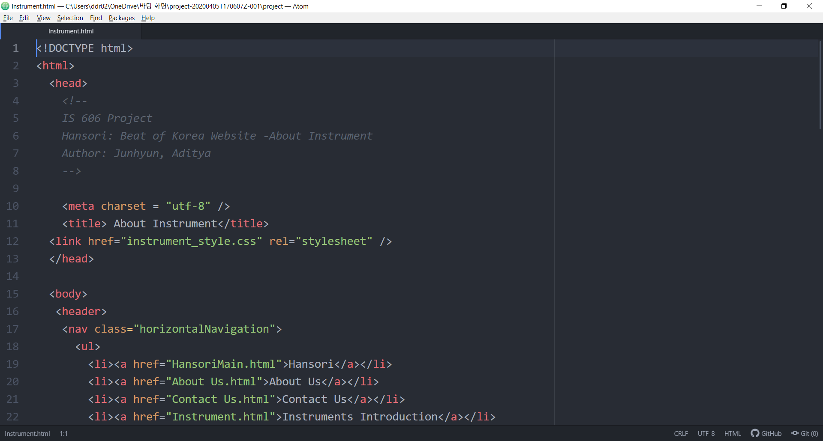
Instruments Introduction Code

Slide 20
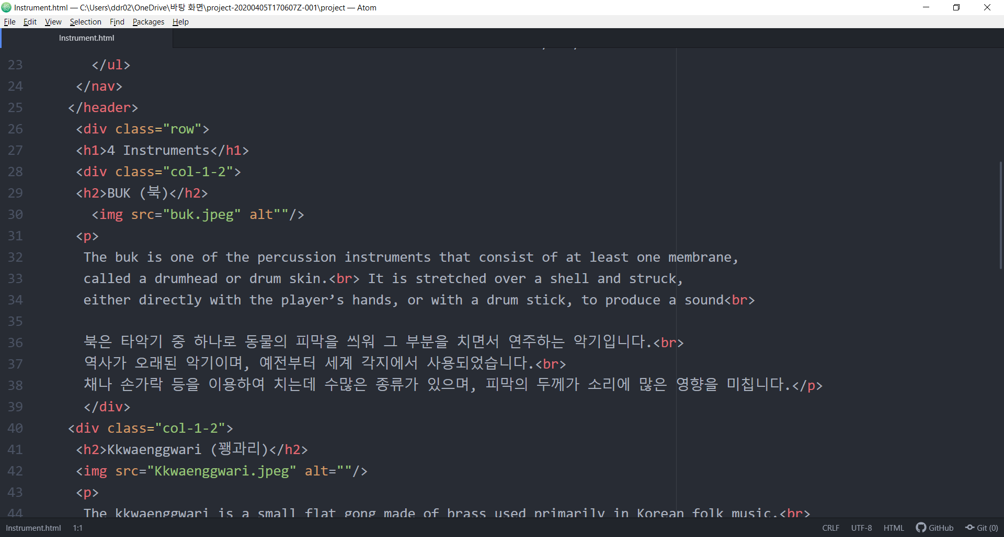

Slide 21
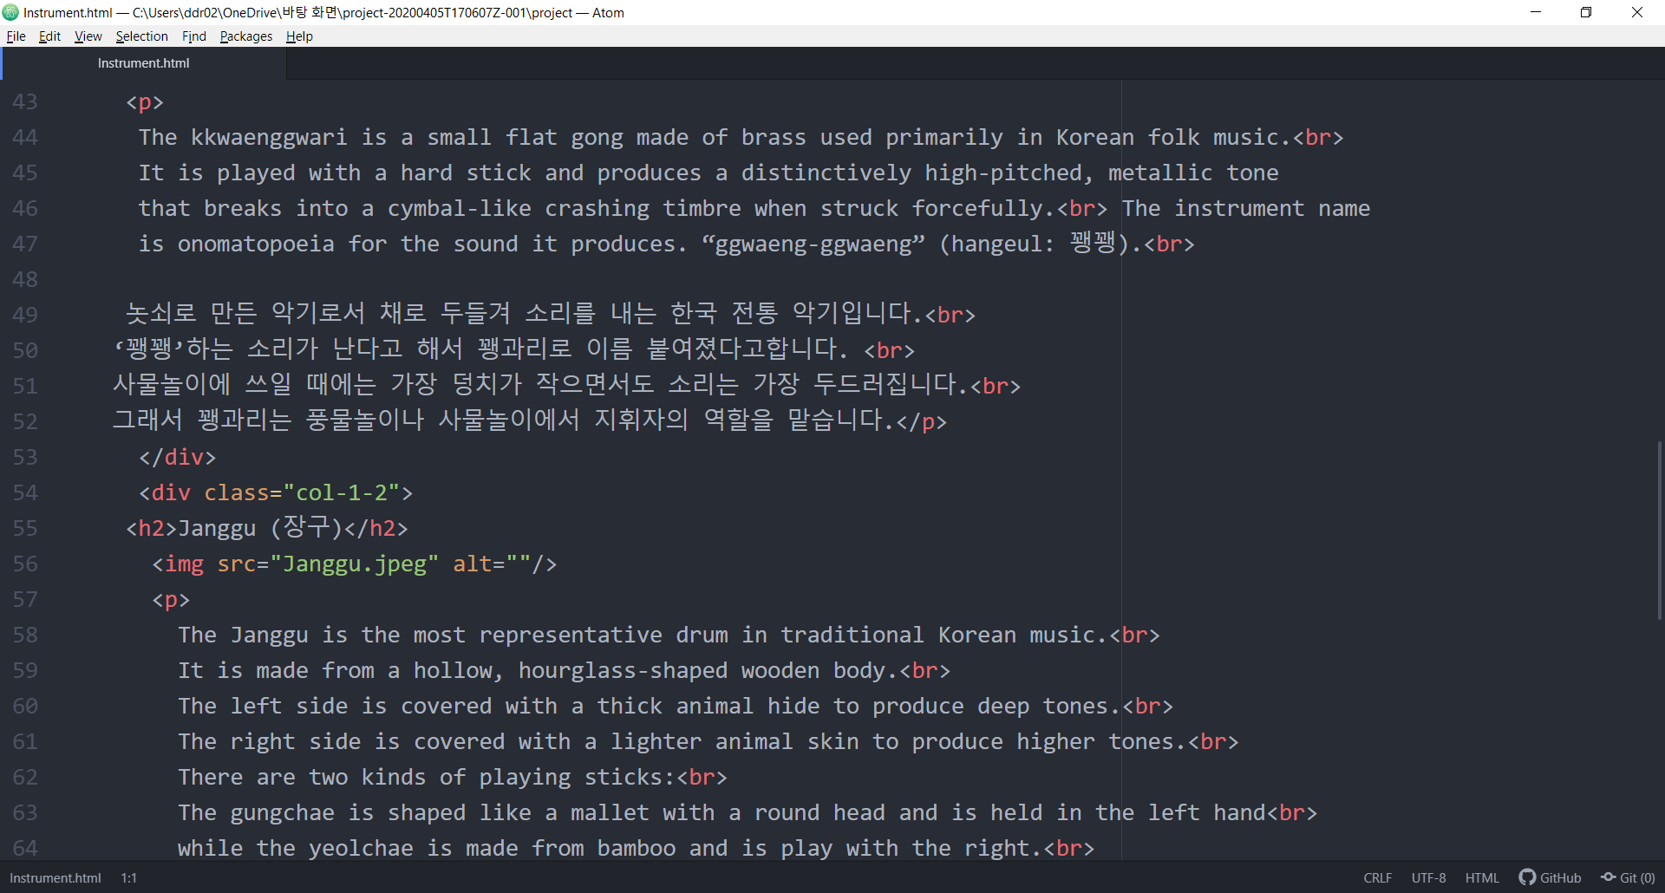

Slide 22
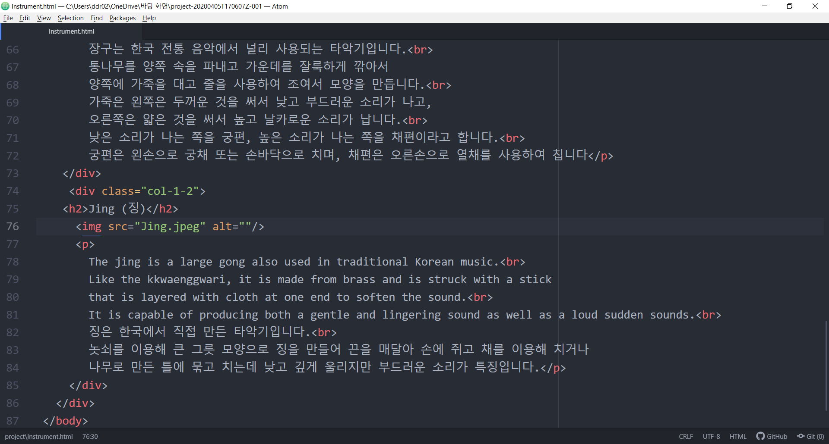

Slide 23
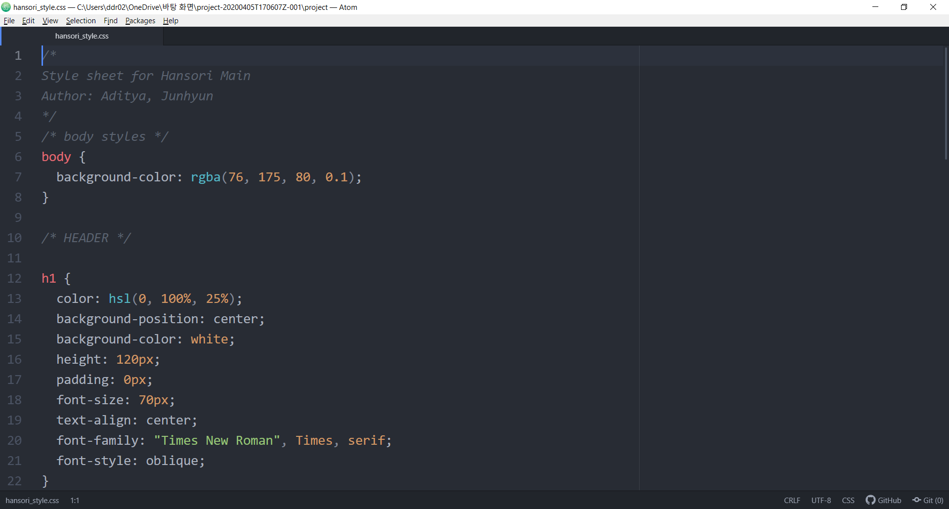
CSS for Hansori Main

Slide 24
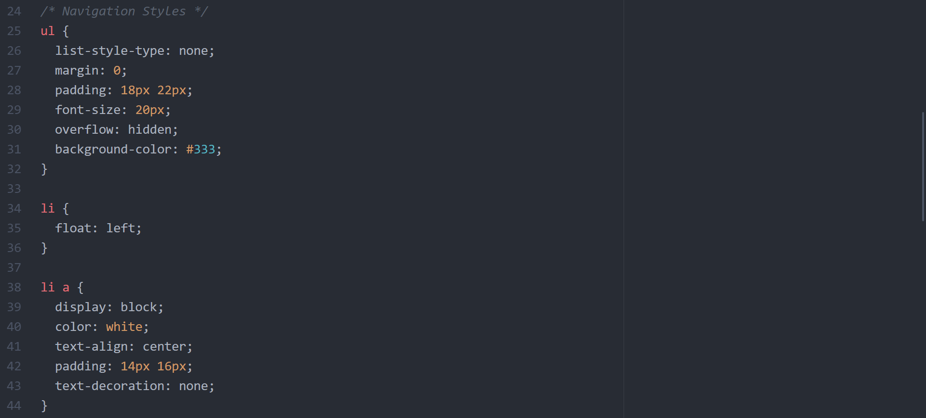

Slide 25
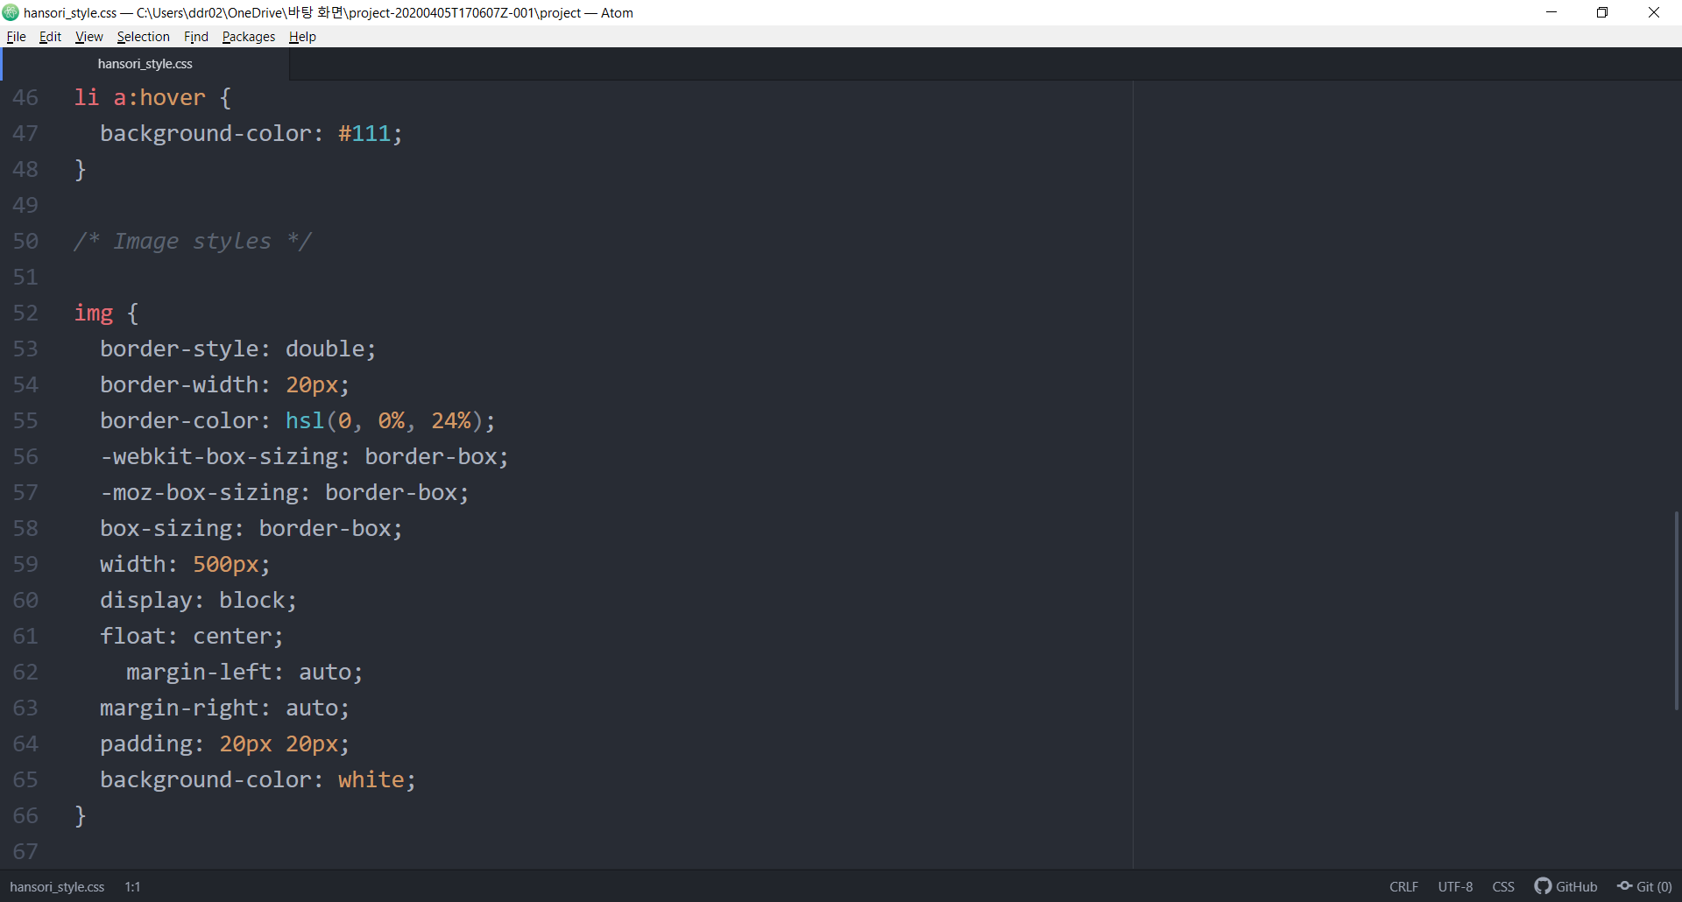

Slide 26
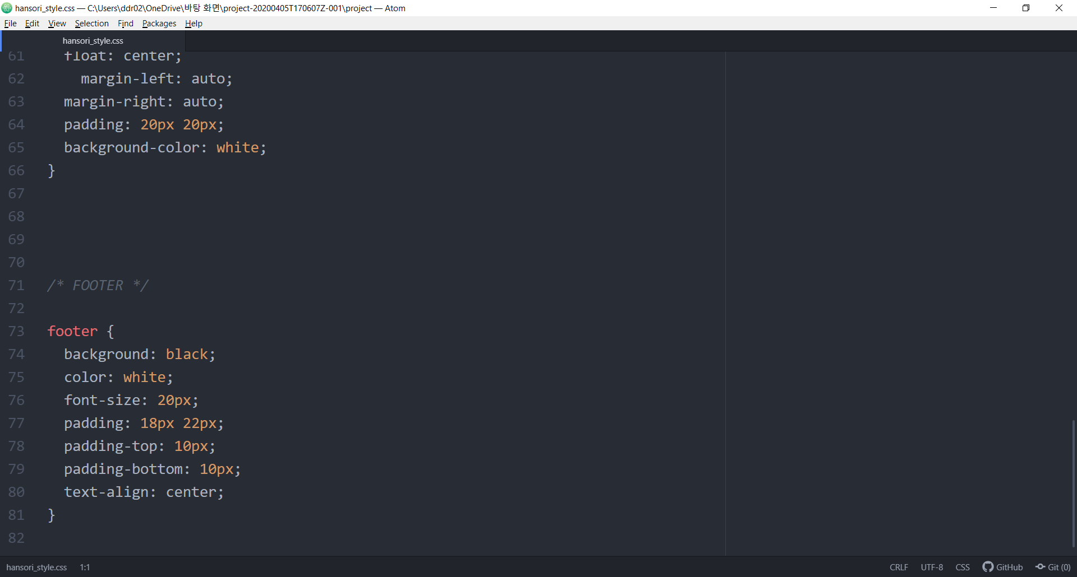

Slide 27
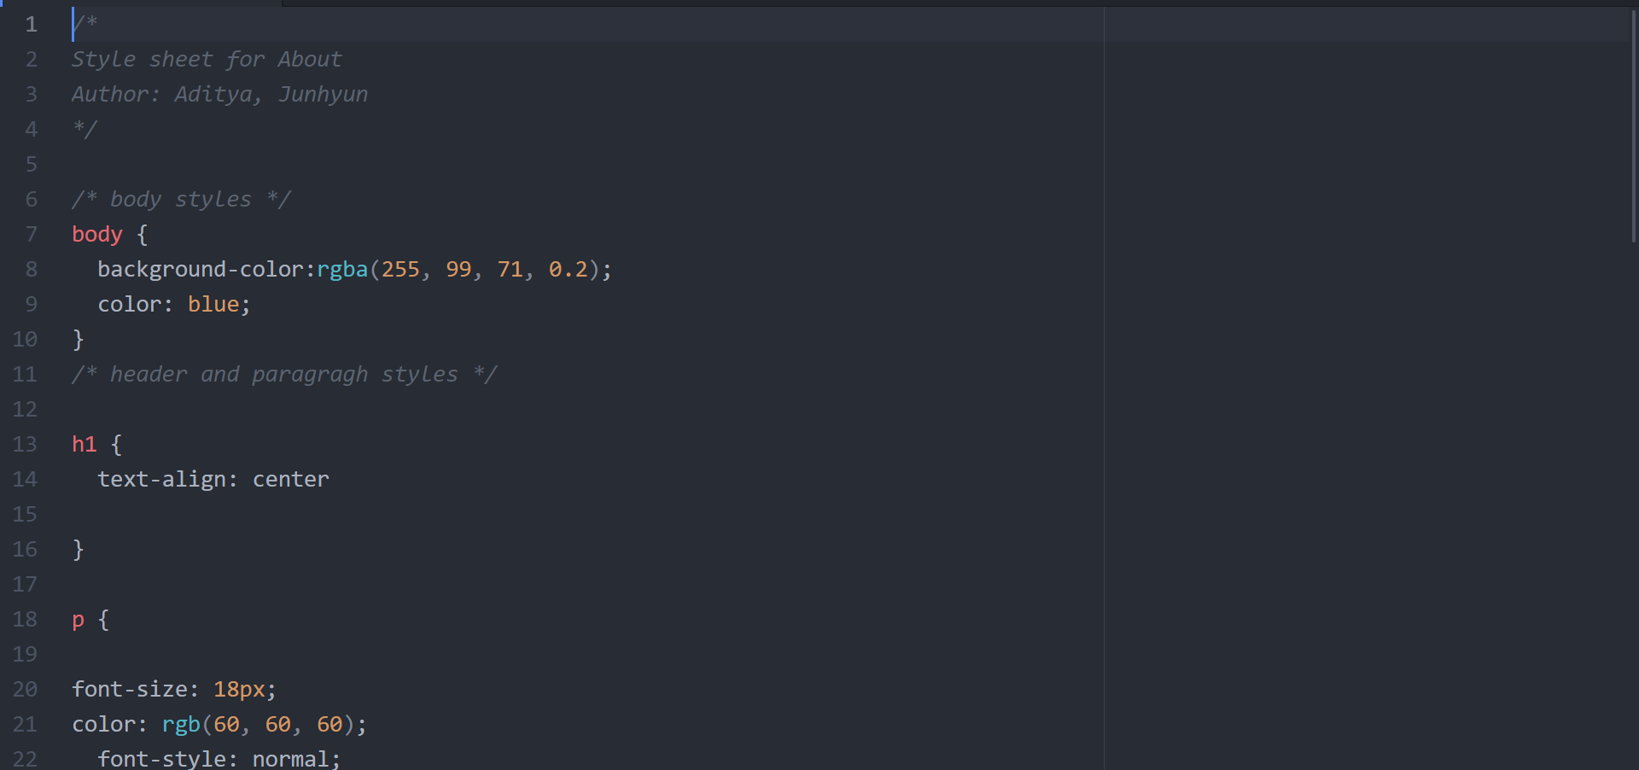
CSS for About Us

Slide 28
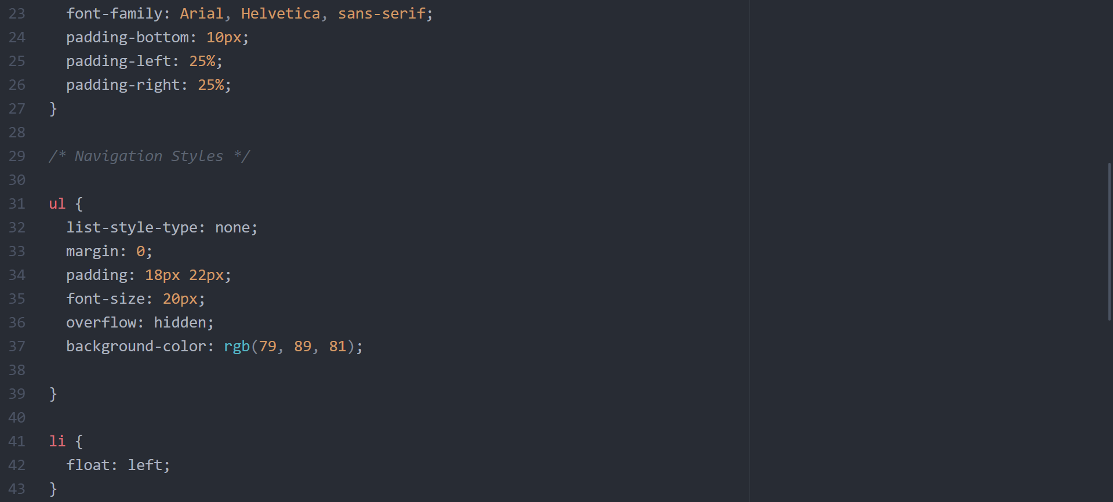

Slide 29
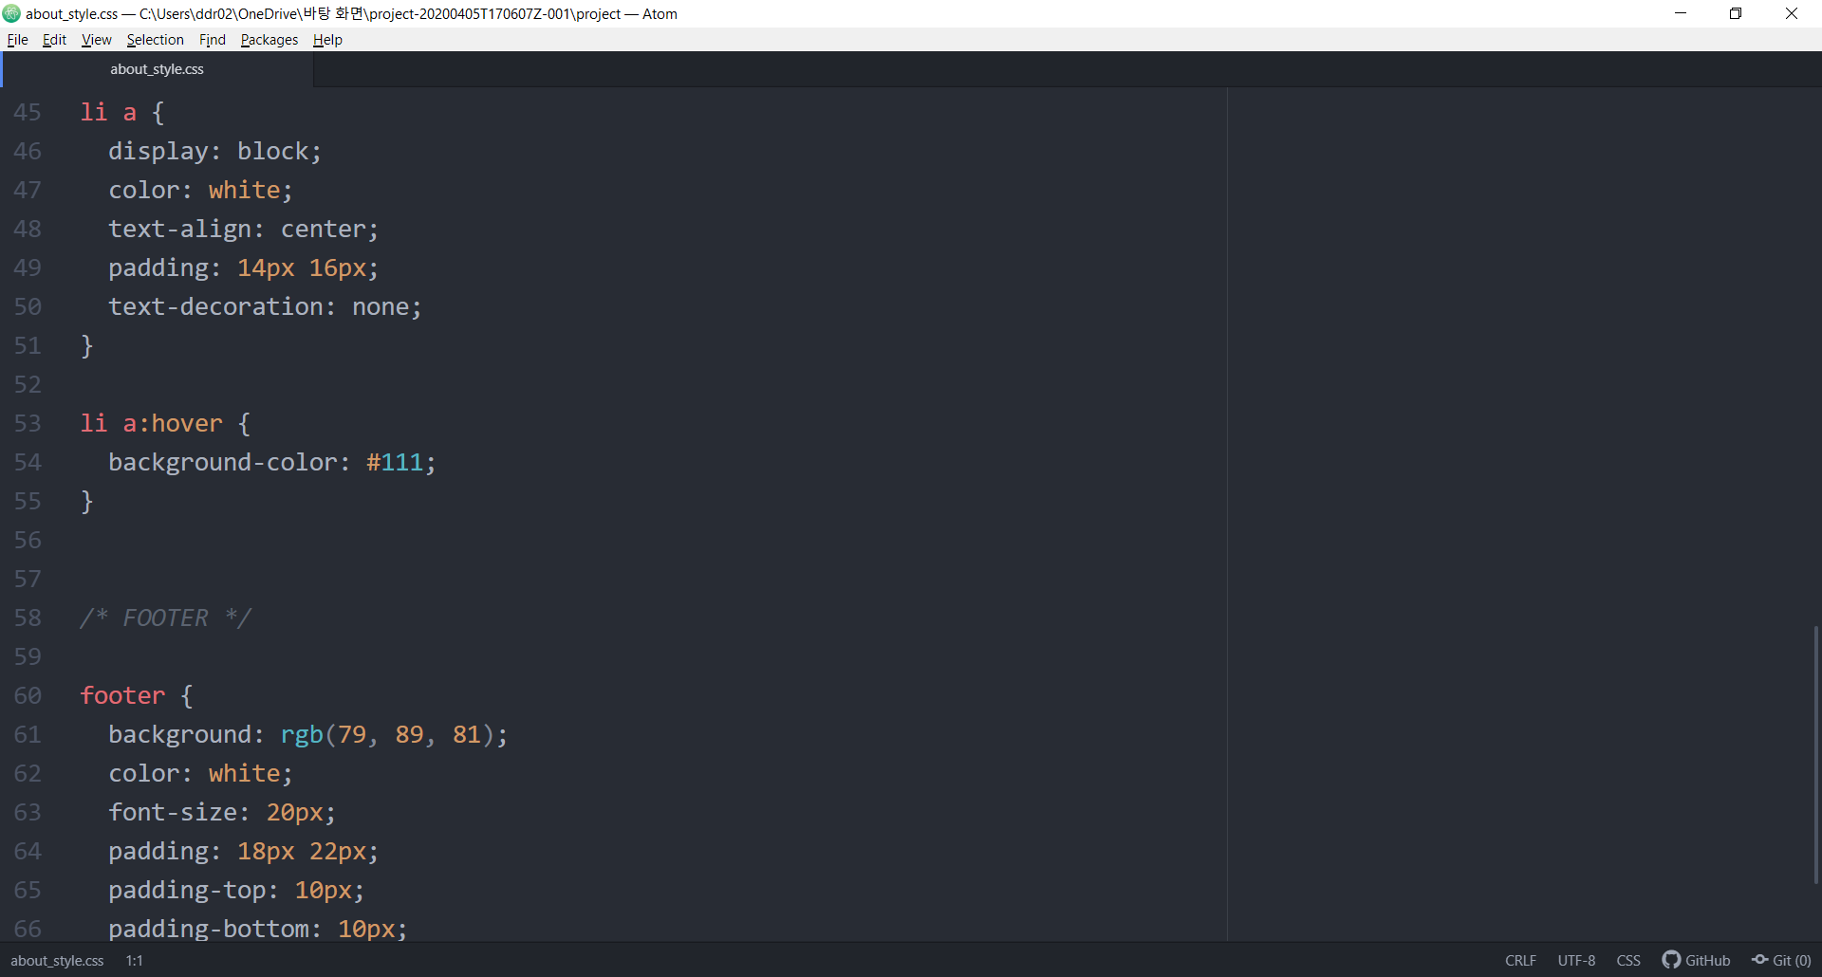
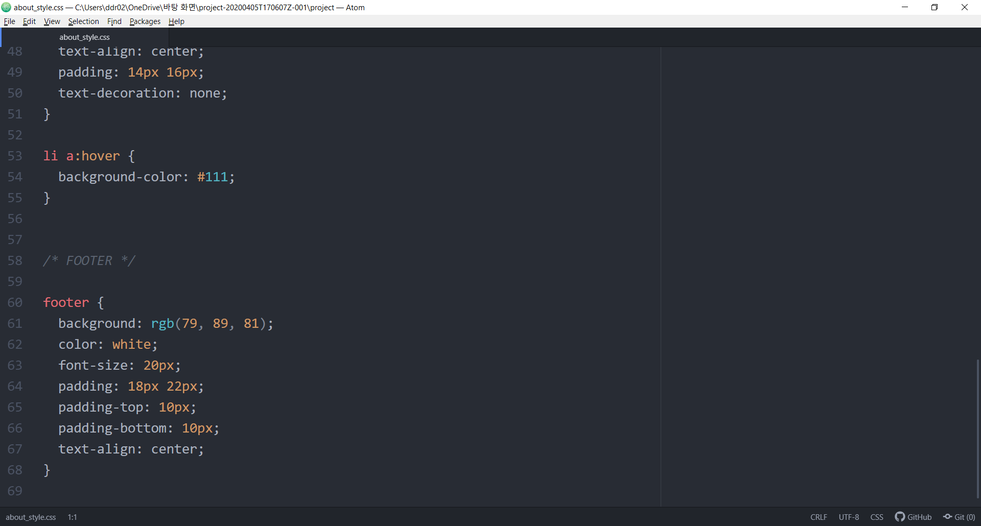

Slide 30
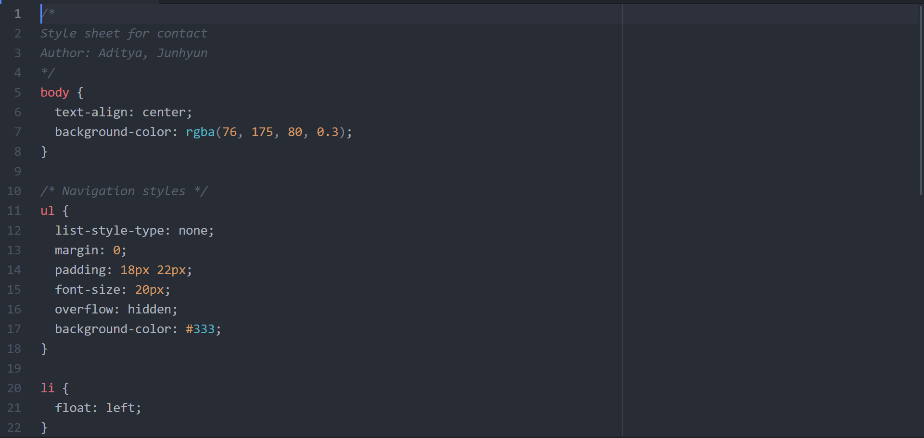
CSS for Contact Us

Slide 31
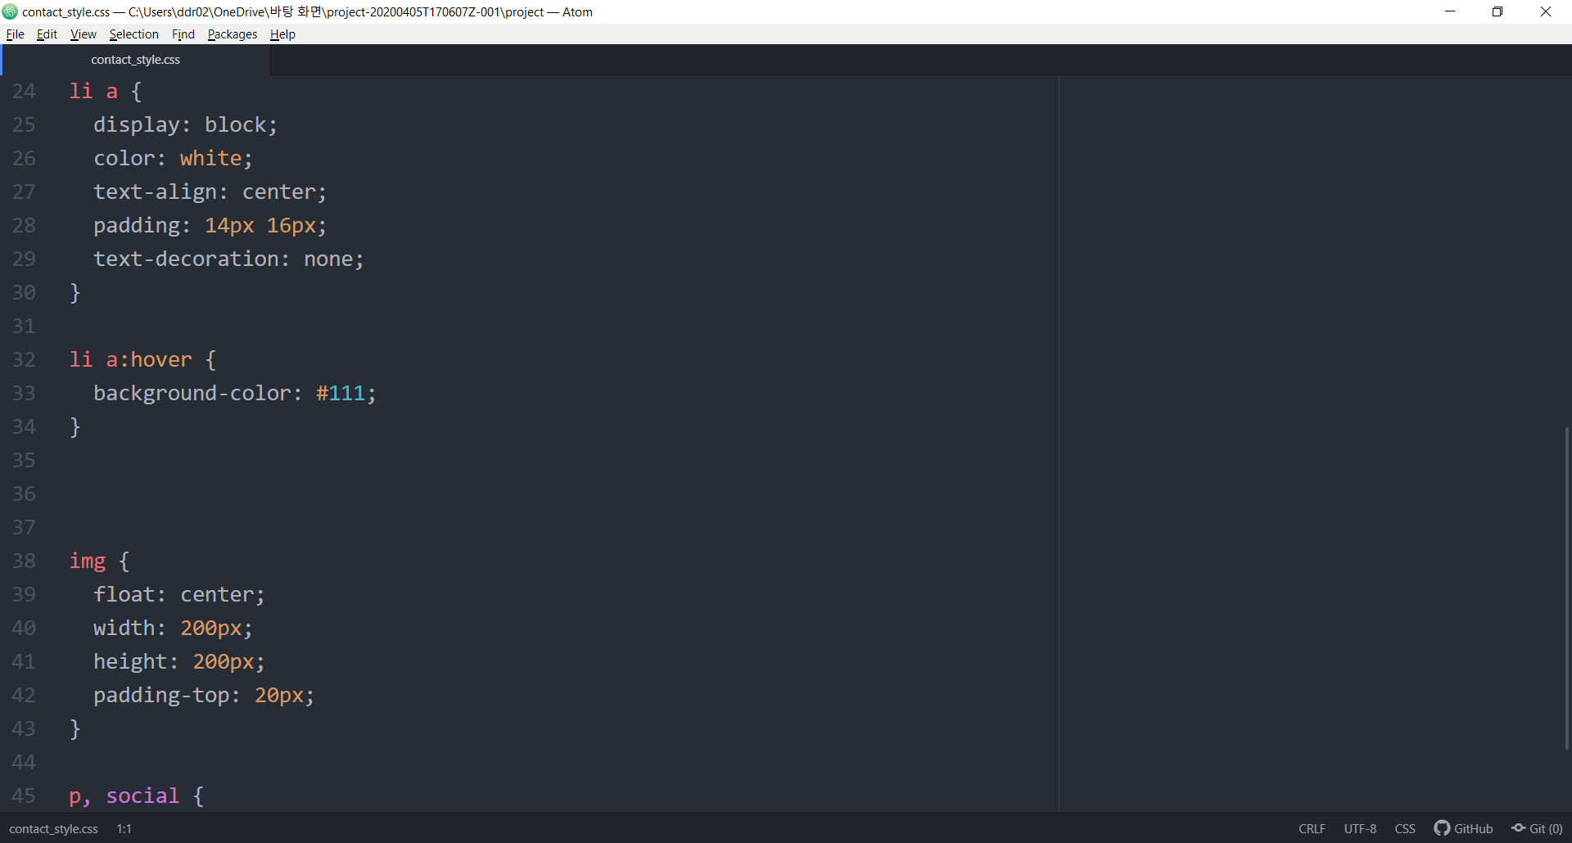
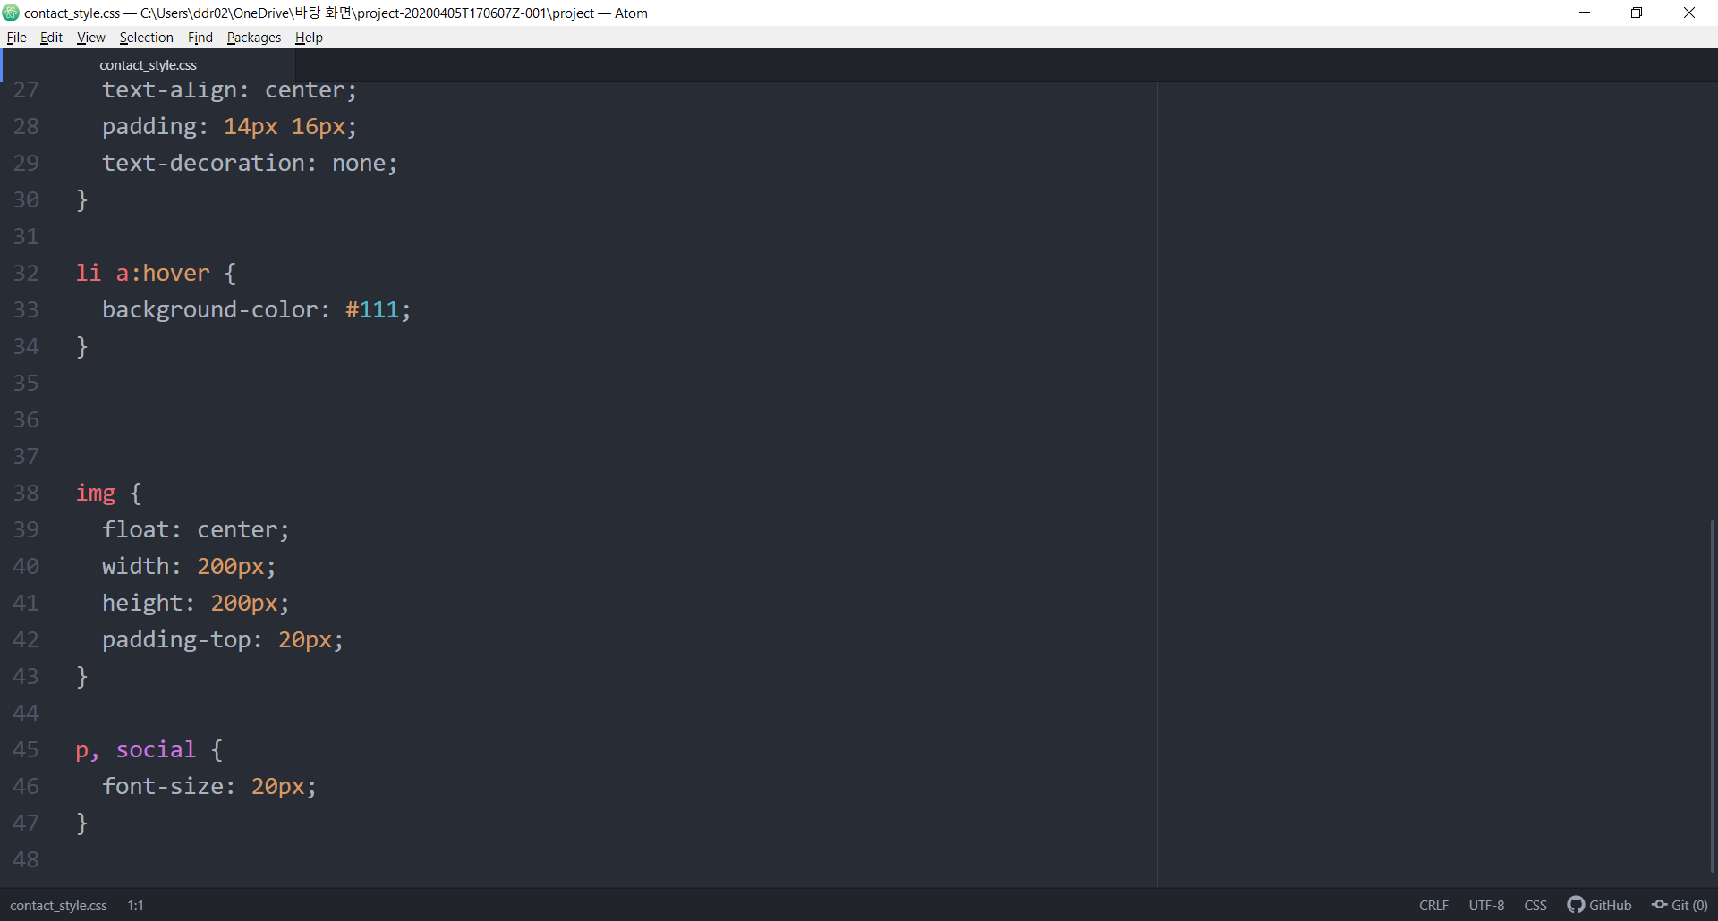

Slide 32
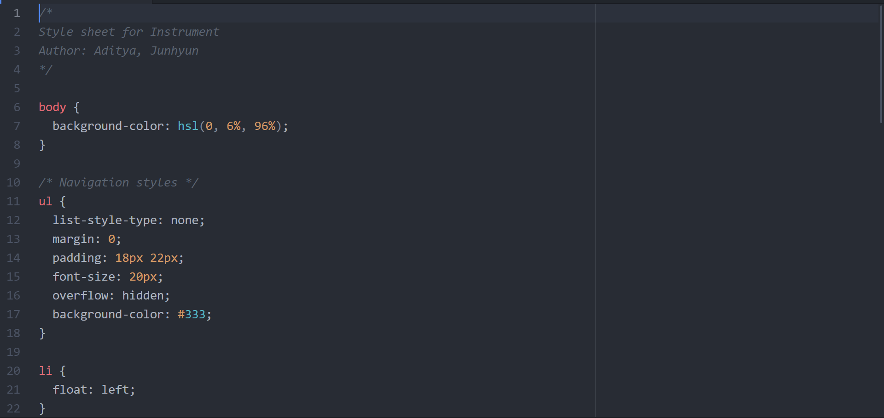
CSS for Instruments

Slide 33
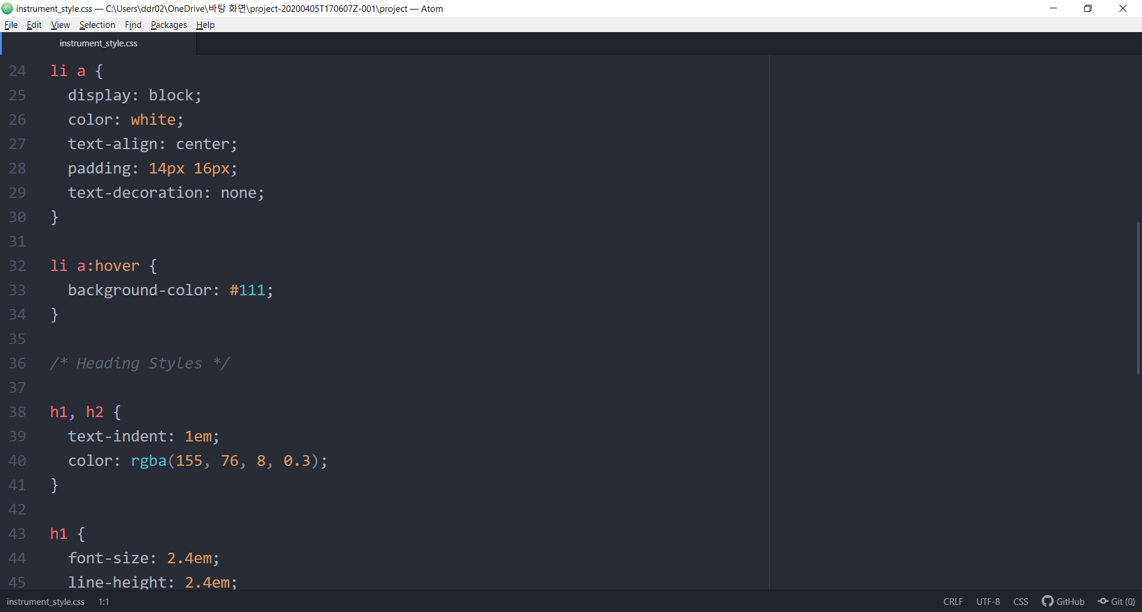

Slide 34
